Slide 1




16 – BIT RISC –V
PROCESSOR
Liyanage D.L.S.B. : EG/2019/3655
Sadeepa P.M.A.S. : EG/2019/3726

Slide 2
TABLE OF CONTENT
Introduction
Block diagram of the architecture
Instruction Types
Description of the instructions
Code for the modules in the architecture
Simulation

Slide 3
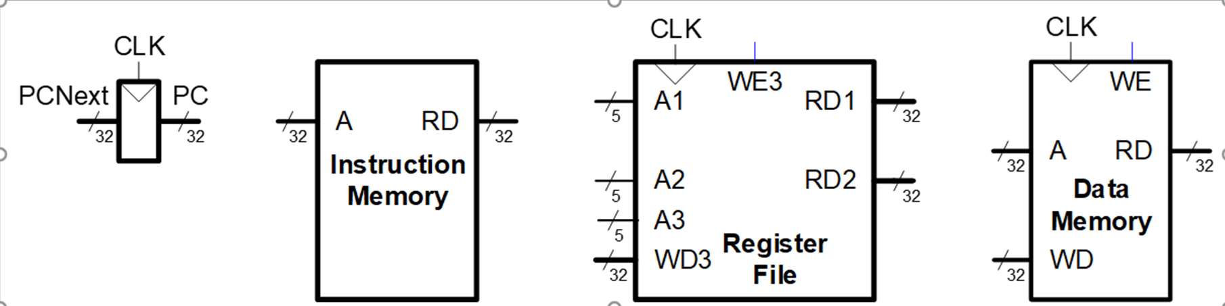

Slide 4

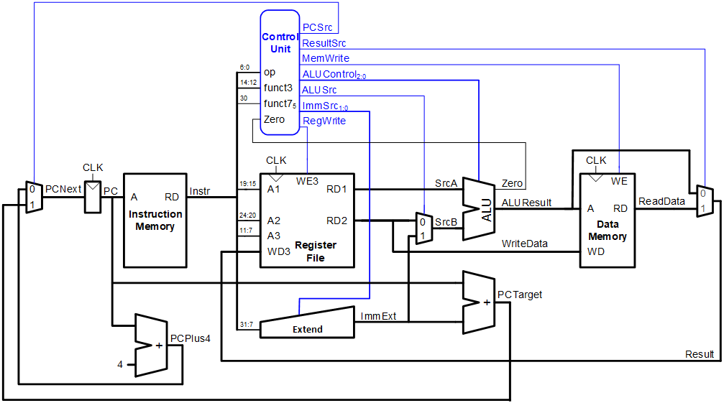

Slide 5


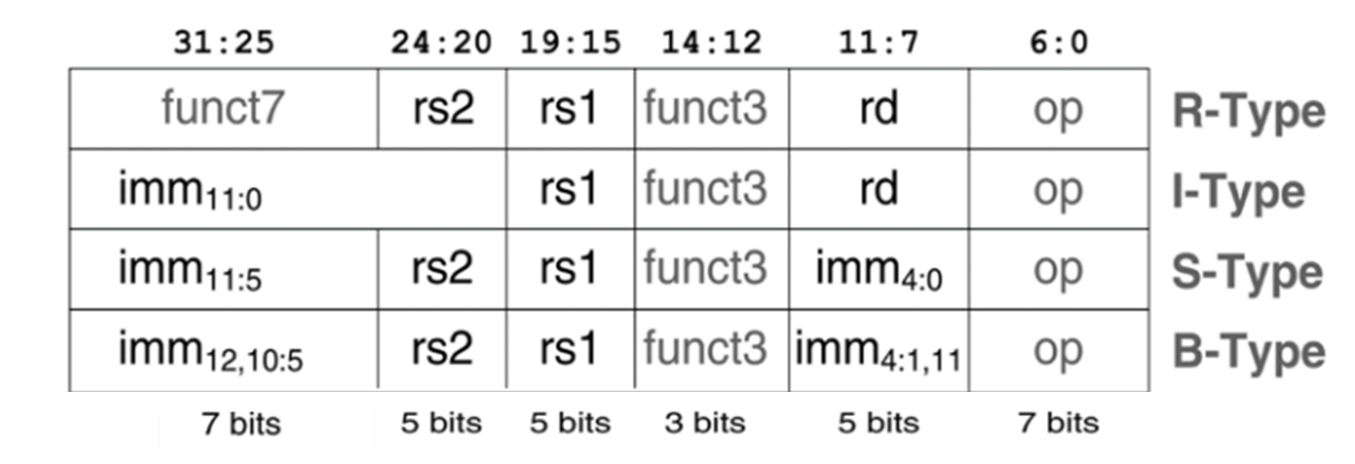

Slide 6

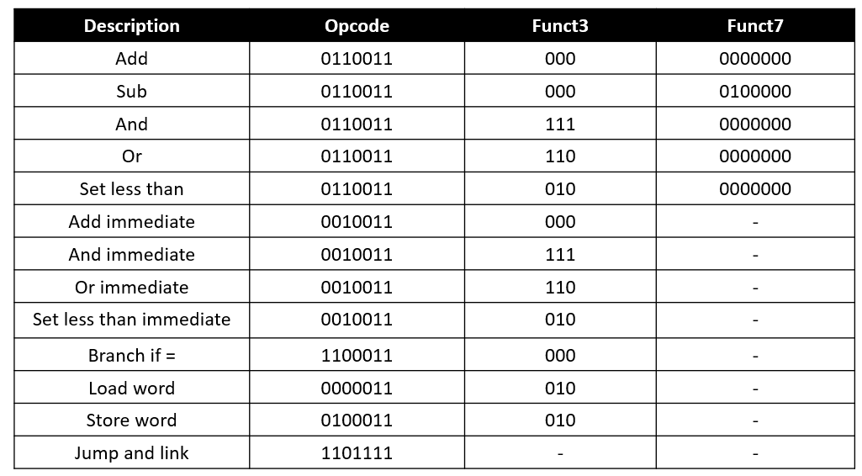

Slide 7

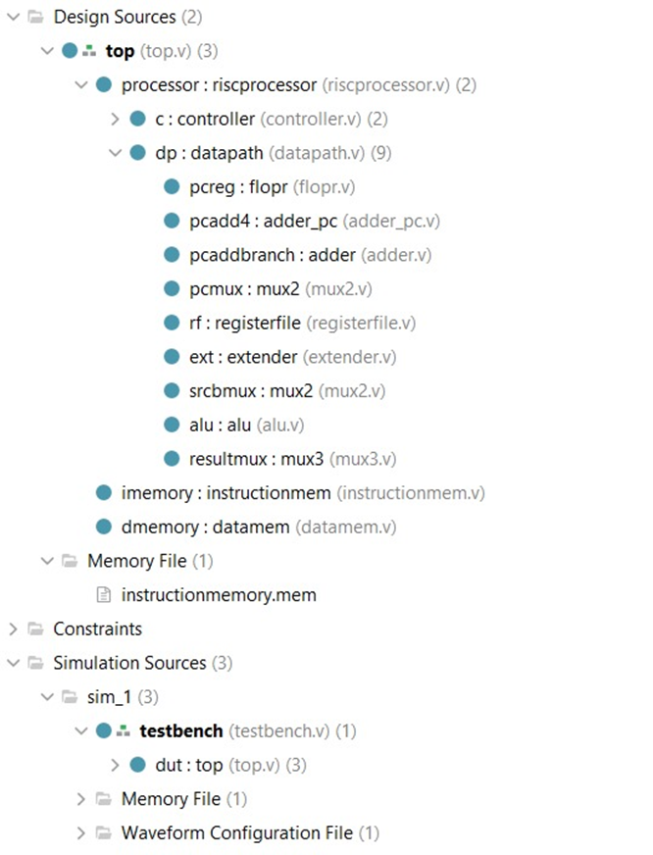

Slide 8

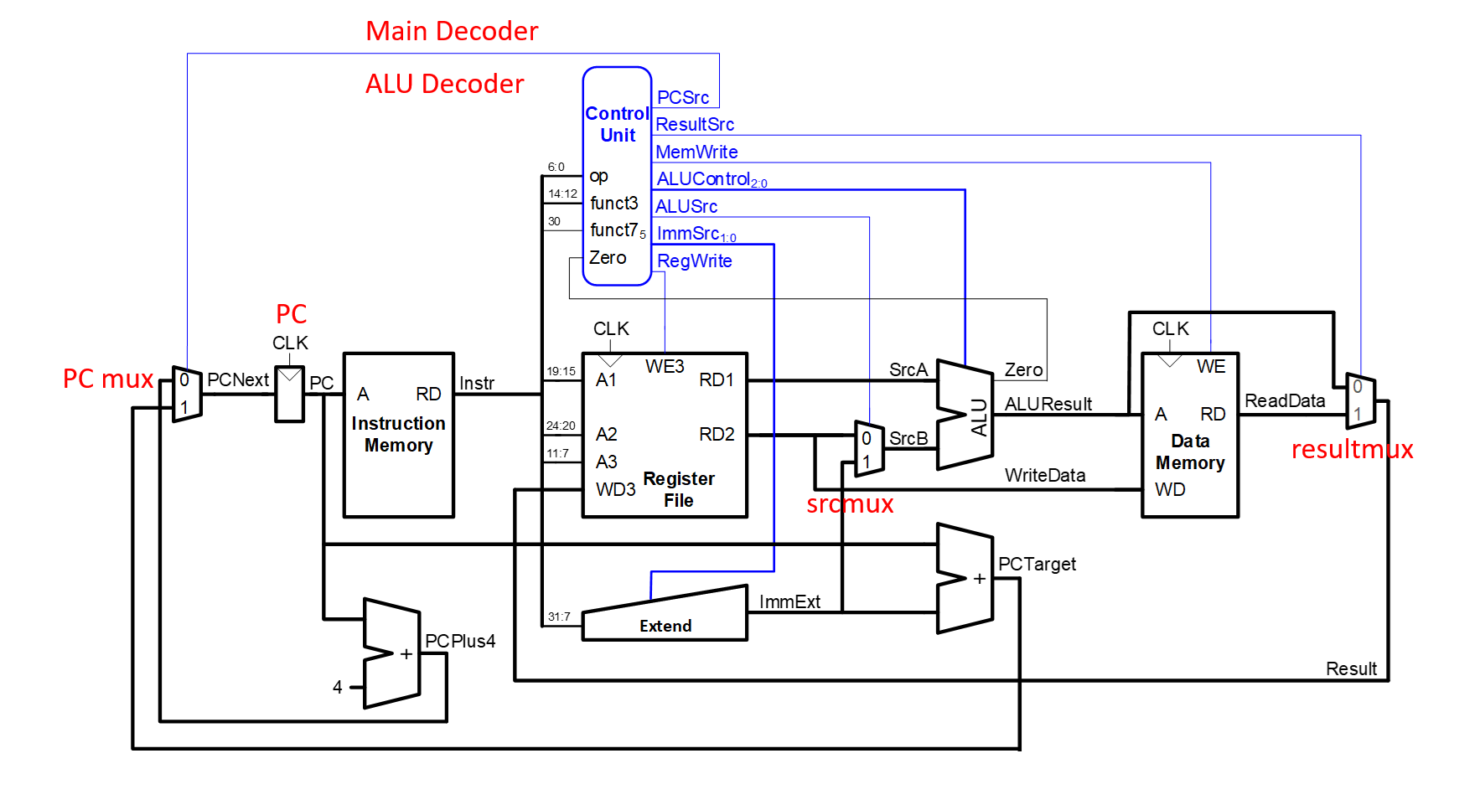

Slide 9
Add immediate Instruction – I type Instruction
000000000101_00000_000_00010_0010011
Immediate : 000000000101 equals to 5
rs1 : 00000 Undefined
function 3 : 000
rd : 00010 Index = 2
Opcode : 0010011
Result should be 5 in the destination register.

Slide 10
Add immediate Instruction – I type Instruction
000000000101_00000_000_00001_0010011
Immediate : 000000000101 equals to 5
rs1 : 00000 Undefined
function 3 : 000
rd : 00001 Index = 1
Opcode : 0010011
Result should be 5 in the destination register.

Slide 11
Add immediate Instruction – I type Instruction
000000001100_00000_000_00011_0010011
Immediate : 000000001100 equals to 12
rs1 : 00000 Undefined
function 3 : 000
rd : 00011 Index = 3
Opcode : 0010011
Result should be 12 in the destination register.

Slide 12
Branch if= Instruction – B type Instruction
0000000_00010_00001_000_01100_1100011
Immediate 1 : 0000000 (12,10:5)
Immediate 2 : 01100 (4:1,11)
Immediate : 0 0 000000 0110 0 Last bit is default 0
rs2 : 00010 index = 2 value =5
rs1 : 00001 index = 1 value =5
function 3 : 000
Opcode : 1100011
The programme counter is on 12th index. Now the programme counter going to the 24th index.

Slide 13
000000000101_00000_000_00001_0010011
000000001100_00000_000_00011_0010011
Programme counter going to the 24th index. Because of that reason these two instructions are not executed.
Add immediate Instruction – I type Instruction
111111110111_00011_000_00111_0010011
The value 3 stored in 7th index

Slide 14
Or Instruction – R type Instruction
0000000_00010_00111_110_00100_0110011
Function7 : 0000000
rs2 : 00010 Index = 2 Value =5
rs1 : 00111 Index = 7 Value =3
function 3 : 110
rd : 00100 Index = 4
Opcode : 0110011
Result should be 7 in the destination register.
Bitwise or operation
5 = 0101
3 = 0011
Result = 0111 =>7

Slide 15
And Instruction – R type Instruction
0000000_00100_00011_111_00101_0110011
Function7 : 0000000 equals to -9
rs2 : 00100 Index = 4Value =7
rs1 : 00011 Index = 3 Value =12
function 3 : 111
rd : 00101 Index = 5
Opcode : 0110011
Result should be 4 in the destination register.
Bitwise AND operation
7 = 0111
12 = 1100
Result = 0100 =>4

Slide 16
Add Instruction – R type Instruction
0000000_00100_00101_000_00110_0110011
Function7 : 0000000 equals to -9
rs2 : 00100 Index = 4Value =7
rs1 : 00101 Index = 5 Value =4
function 3 : 000
rd : 00110 Index = 6
Opcode : 0110011
Result should be 11 in the destination register.

Slide 17
Store word Instruction – S type Instruction
0000000_00111_00101_010_00101_0100011
Immediate 1 : 0000000 (11:5)
Immediate 2 : 00101 (4:0)
Immediate : 0000000 00101 value = 5
rs2 : 00111 index = 7 value =3
rs1 : 00101 index = 5 value =4
function 3 : 010
Opcode : 0100011
When this instruction executes, the register file reads base address 0x0004 from index 5. Immediate is equal to 5. The ALU computes 0x0004 + 5 = 0x0009. As the rs2 is 00111 register file reads the value 3 from that index and sends it to data memory. Therefore data memory writes 3 to RAM[9].

Slide 18
Load word Instruction – I type Instruction
111111111100_00100_010_01011_0000011
Immediate : 111111111100 (11:5) value = -4
rs1 : 00100 index = 4 value =7
function 3 : 010
rd : 01011 index = 11
Opcode : 0000011
As the instruction is lw opcode and function3 should be 0000011 and 010 respectively. In the example instruction source register is 00100 and it is the 4th index of the register file. Here index 4 contains 0x0007. As immediate is 111111111100 it is equivalent to -4. Therefore the ALU operation gives us 3. So the processor reads index 3 from the RAM and writes back it into the destination register of the register file. In this example RAM[3] initialises with the value 9. So 9 will write back to the destination register 01011 of the register file. Therefore index 11 of the register file stores value 9 after executing this instruction.

Slide 19
Or Immediate – I type Instruction
000000000011_00100_110_01010_0010011
Immediate : 000000000011 (11:5) value = 3
rs1 : 00100 index = 4 value = 7
function 3 : 110
rd : 01010 index = 10
Opcode : 0010011
Result should be 7 in the destination register.
Bitwise OR operation
3 = 0011
5 = 0101
Result = 0111 =>7

Slide 20
AND Immediate – I type Instruction
000001010011_00110_111_01100_0010011
Immediate : 000001010011 (11:0) value = 163
rs1 : 00110 index = 6 value = 11
function 3 : 111
rd : 01100 index = 12
Opcode : 0010011
Result should be 3 in the destination register.
Bitwise OR operation
163 = 1010 0011
5 = 0000 0111
Result = 0011 =>3

Slide 21
Set less than Instruction – R type Instruction
0000000_00100_00101_010_01101_0110011
Function7 : 0000000
rs2 : 00100 Index = 4Value =7
rs1 : 00101 Index = 5 Value =4
function 3 : 010
rd : 01101 index = 13
Opcode : 0110011
rd = rs1 < rs2 when this is true rd = 1 , otherwise rd = 0
Result should be 1 in the destination register.

Slide 22
Setless than immediate Instruction – I type Instruction
000000001010_00010_010_01110_0010011
Immediate : 000000001010 (11:0) value = 10
rs1 : 00010 index = 2 value = 5
function 3 : 010
rd : 01110 index = 14
Opcode : 0010011
rd = rs1 < SignExt(immediate) when this is true rd = 1 , otherwise rd = 0
Result should be 1 in the destination register.

Slide 23
THANK
YOU

